Slide 1
Resiliency Work in CLAMR
Oct 27, 2014
LA-UR-14-28290
Bob Robey
XCP-2 Eulerian Codes Group
Nathan DeBardeleben
Qiang Guan
Ultrascale Systems Research Center
HPC-5
Los Alamos National Laboratory
Brian Atkinson
Clemson University
William Jones
Coastal Carolina University

Slide 2
Ultrascale Systems Research Center Los Alamos National Laboratory
Bringing Science to the analysis of system failures
Mining system logs for failure patterns – DRAM failures
Fault injection Studies – F-SEFI fault injection Framework

Slide 3
CLAMR – Cell-based Adaptive Mesh Refinement Hydrodynamics Mini-App
Reflects the cell-by-cell refinement used in many of LANL codes
Uses the Shallow Water equations for simplicity
Open Source at http://github.com/losalamos/CLAMR
CLAMR runs on GPUs, MICs, multicore, and multi-node with MPI
Has real-time visualization to accelerate development

Slide 4
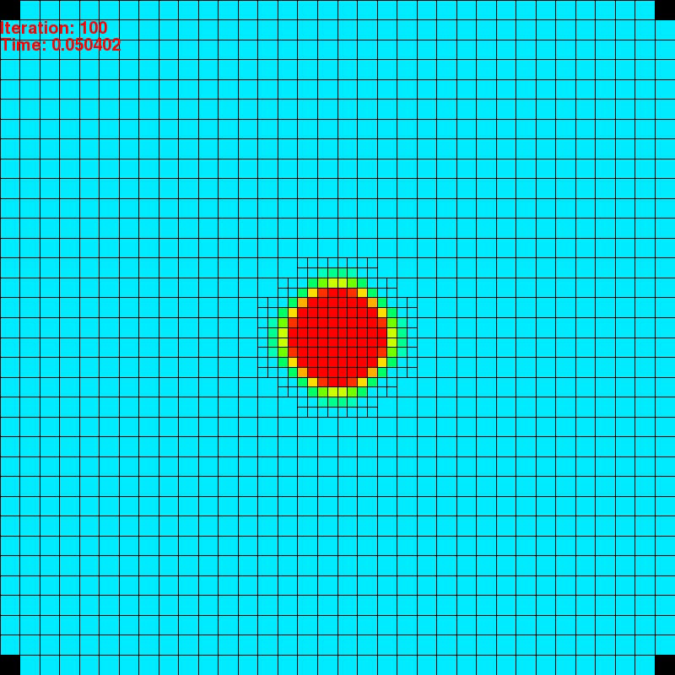
Circular Dam Break Simulation
Cylindrical pulse is created at center of mesh
Uses conservation of mass and momentum and explicit time-stepping to calculate the wave propagation
Challenging problem
Sharp rise at dam break
Need to maintain spherical symmetry
Near zero (or dry) condition at center of problem caused by waves moving outward

Slide 5
Fault Injection Study
Target core CLAMR function – calc_finite_difference
Insert fault randomly using FADD instruction to simulate memory error
Possible outcomes:
Benign – does not manifest in any changes to simulation
Crash – simulation becomes unstable, often resulting in negative masses, NaNs and the system aborts
Silent Data Corruption (SDC) – most dangerous outcome

Slide 6
The Fault Injection Experiment
Initial experiment -- 500 fault injections
more recent campaigns have been > 5,000
32x32 grid
Extremely small grid but recent studies have been on larger grids
Larger grid, while improving accuracy, does not impact fault tolerance
Random iteration
Random bit pattern
Single bit flip

Slide 7
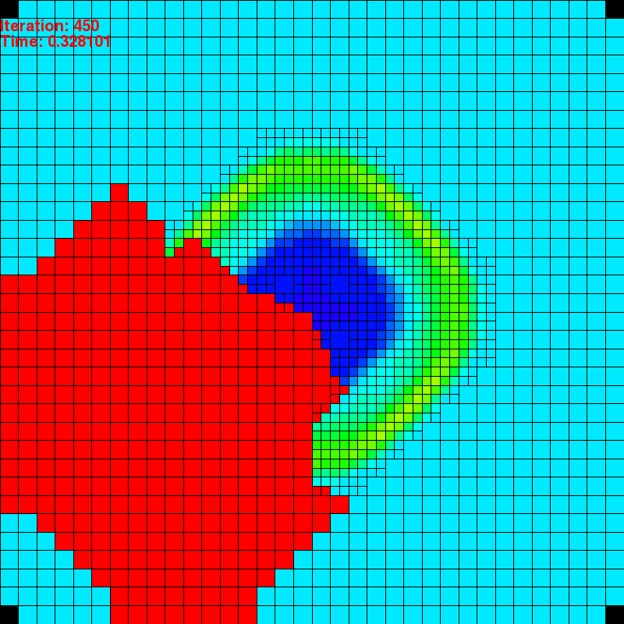
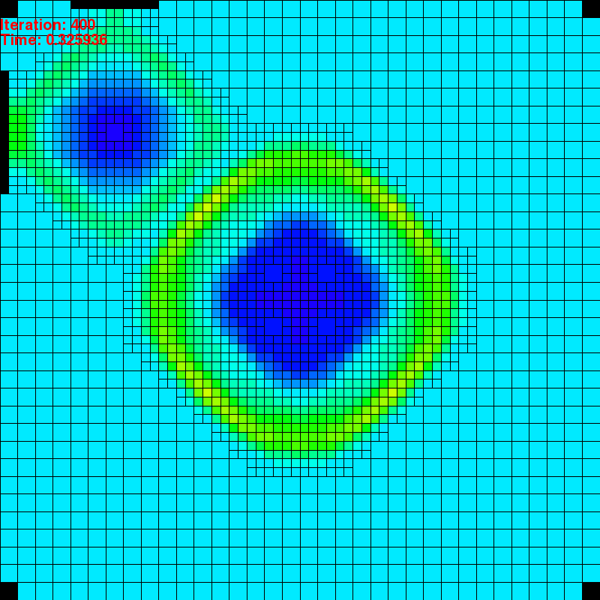
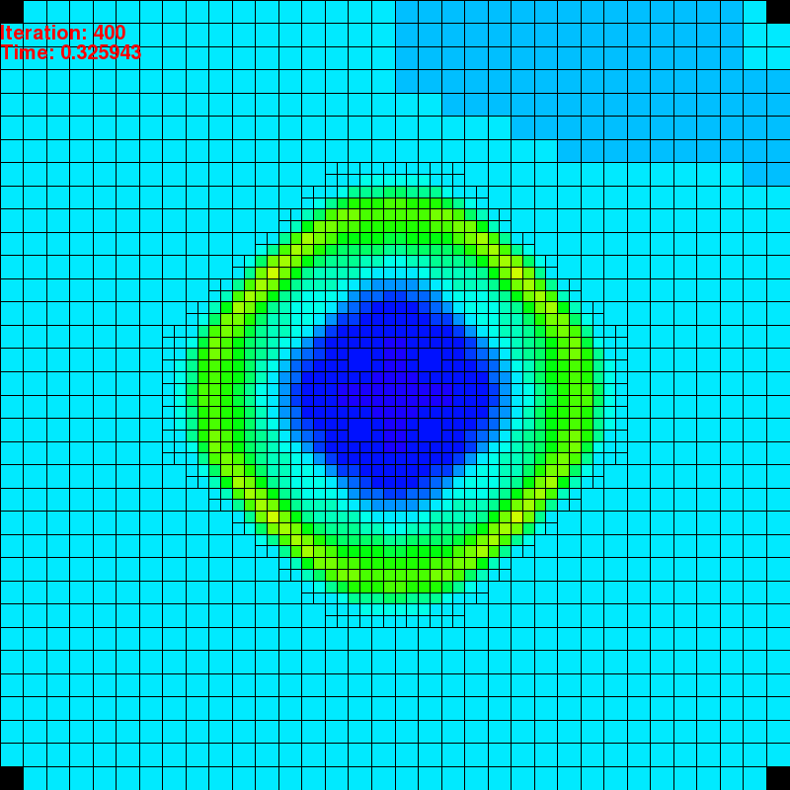
Examples of Failure Modes
Crash
Two Different
Silent Data Corruptions

Slide 8
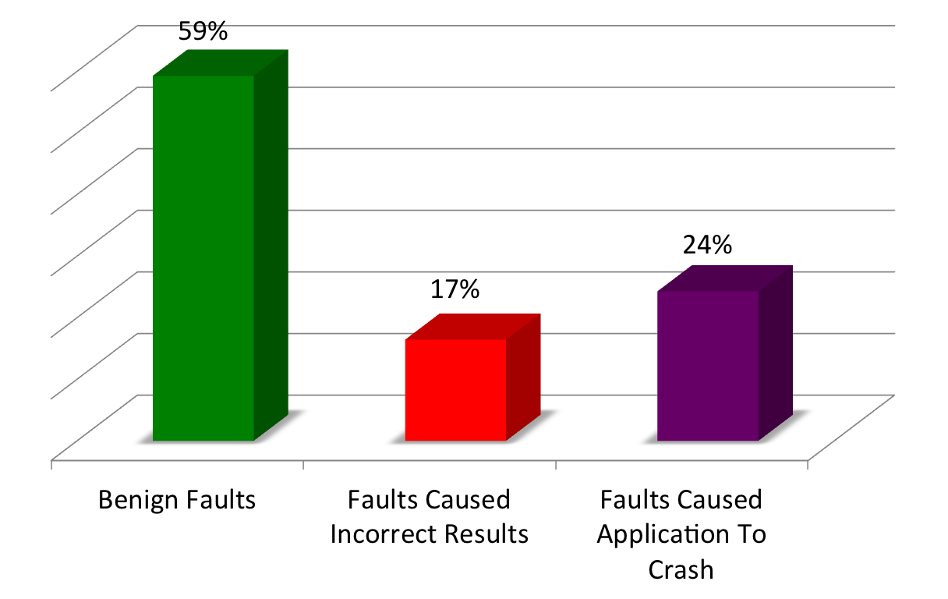
Fault Injection Experiments – Results
CLAMR shows surprising resilience – 59% of faults injected at this location have no effect (benign)
17% result in SDC
24% cause CLAMR to crash
More recent studies
give slightly different
results which will be
detailed in a longer talk.

Slide 9
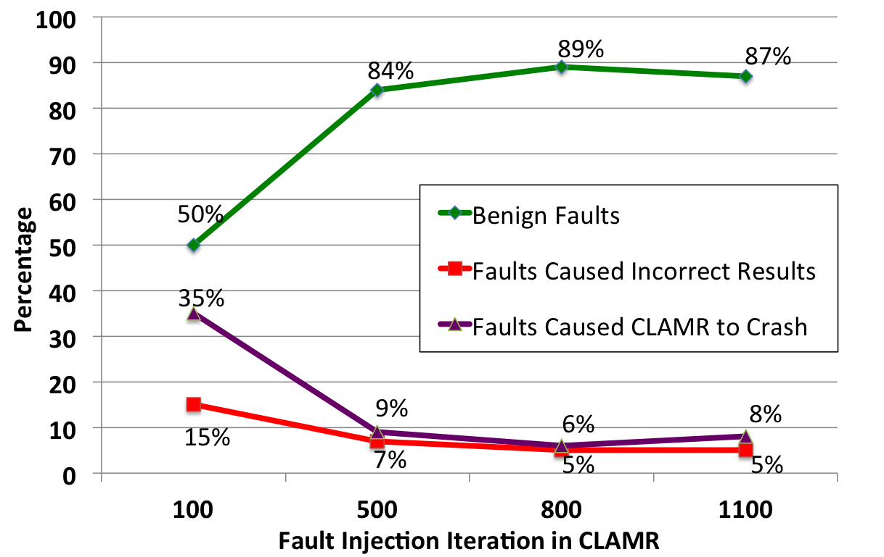
Fault Injection Experiments With Respect to Simulation Time
Studied 4 injection time steps (100, 500, 800, 1100)
As the simulation goes on, more of the faults injected result in no effect
Possible reason is that early on the mesh is smaller (not refined) and changes have large effects. Needs more study.

Slide 10
Fault Detection Methods
Fault Detection Methods
Compare graphics
Compare checkpoint dumps
Check total mass

Slide 11
Fault Recovery
If you can detect fault, why not recover?
Use total mass conservation (but need high quality measure)
Enhanced precision sums improves sum consistency from around 7 digits to 15 digits
Kalman filter
Checkpoints
File-based
In-memory (only difference is file open statement)
SSD – future plan

Slide 12
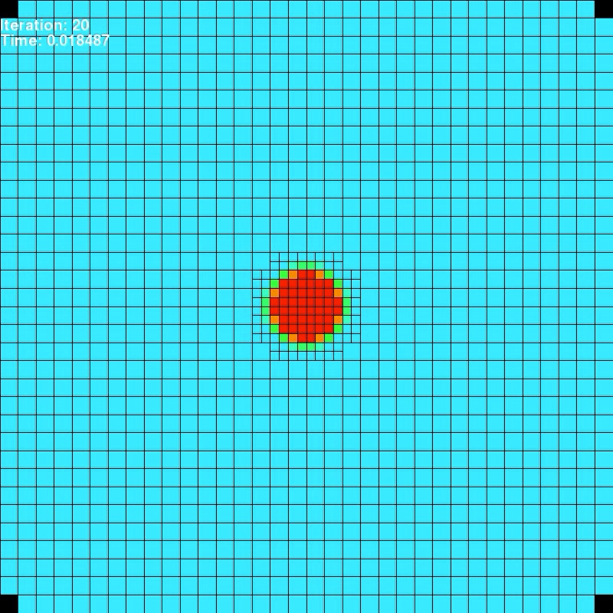
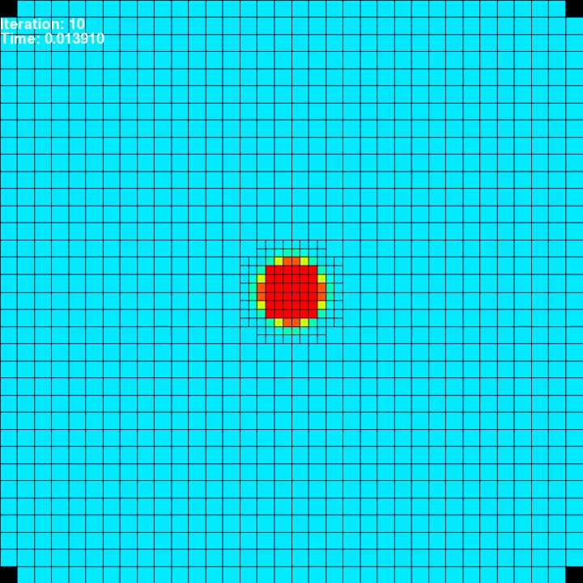
What does a recovery look like?
Fault Recovery from 2nd rollback and another single rollback recovery
Slow Motion

Slide 13
Conclusions and Future Work
Conclusions
Used F-SEFI to inject faults into precise locations of a DOE mini-app, CLAMR
~41% of the faults cause problems (crashes or silent data corruption)
Shown that when a fault is injected impacts how tolerant CLAMR is to that injection
Show visualizations of how faults cause corruption in CLAMR
Future Work
Need more fault injections to establish statistical confidence.
This experiment was to demonstrate the usefulness of F-SEFI in performing this type of study
Develop fault detection and correction mechanisms

Slide 14
Co-design Impacts
… or should it be
Cross-group Collaboration
Added file-based graphics
Movie Generation
Checkpointing and Restart (libcrux)
Automatic Recovery
In-memory checkpoints with reduction of data having to go to disk
Thanks to – Brian Atkinson, Qiang Guan, and Nathan DeBardeleben

